Slide 1

OLIST BUSINESS ANALYSIS PRESENTATION
Engy Mohamed Ibrahim Sayed

Slide 2


Olist Intro
Olist is an e-commerce platform that started in 2016 to connect small and medium-sized businesses to customers. The platform operates as a marketplace, where merchants can list their products and services and customers can browse and purchase them online

Slide 3

TABLE OF CONTENTS
01
02
03
04
05
06
Business Overview
Category Analysis
Orders Frequency
How Much Did the Profit increase since the Business Started?
What are the Categories that generate the highest and lowest Profit?
What are the Most & Least Frequently Ordered Categories?
Payment Analysis
Geological Analysis
Time-Series Analysis
What are the Payment Methods Used by our customers?
How Long does it take for an order to arrive to the Customer?
Where does the Business Generate the highest & lowest Profit?

Slide 4
Q1
How Much Did the Profit increase since the Business Started?

Slide 5

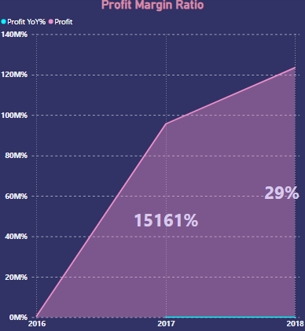
PMR Over Time
The Business Started in September 2016 ending the year with a profit value of 6,271.06
In 2017, The Business started to grow generating a Total profit of 957,004.18 which makes a Profit Margin Ratio of 15161.28% from 2016
In 2018, The Business generated a Total Profit of 1,234,633.91, which makes a Profit Margin Ratio of 29% from 2017

Slide 6
Q2
What are the Categories that generate the highest and lowest Profit?

Slide 7

Top 5 Profitable Product Categories:
Least 5 Profitable Product Categories:
Bed Bath Table: 204,693.04
Health Beauty: 182,566.73
Furniture Décor: 172,749.30
Sports Leisure: 168,607.51
Computer Accessories: 147,318.08
Security & Services: 41,22
Fashion Children Clothes: 95,51
CDs-DVDs-Musicals: 224.99
La Cuisine: 333.55
Arts and Craftmanship: 370.13

Slide 8

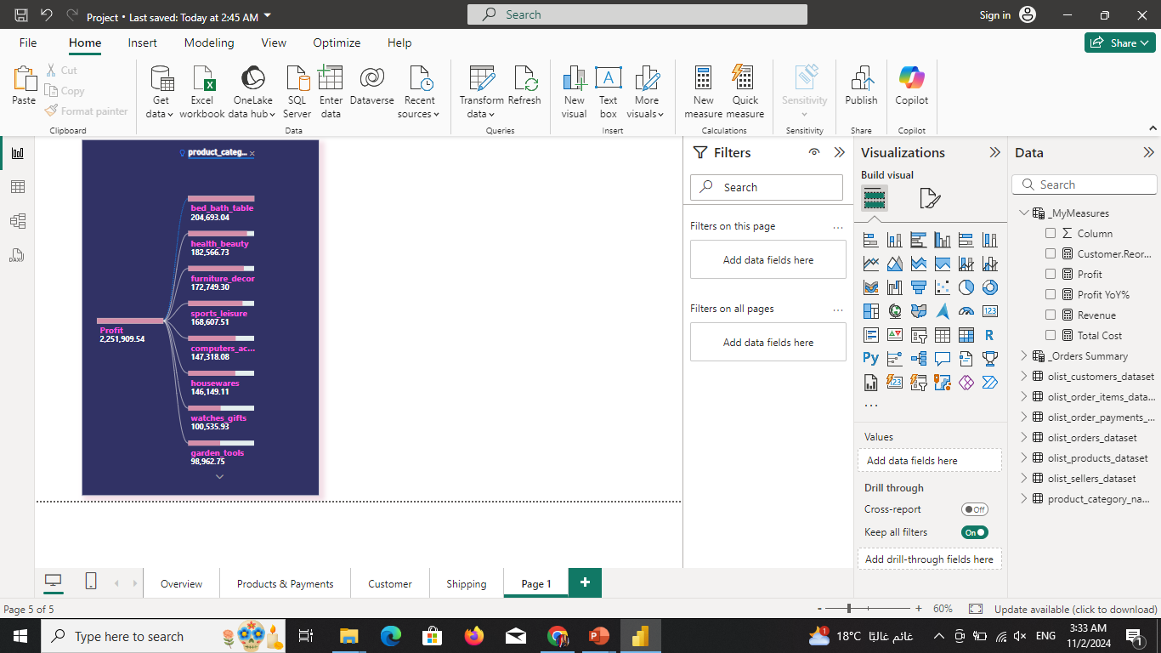
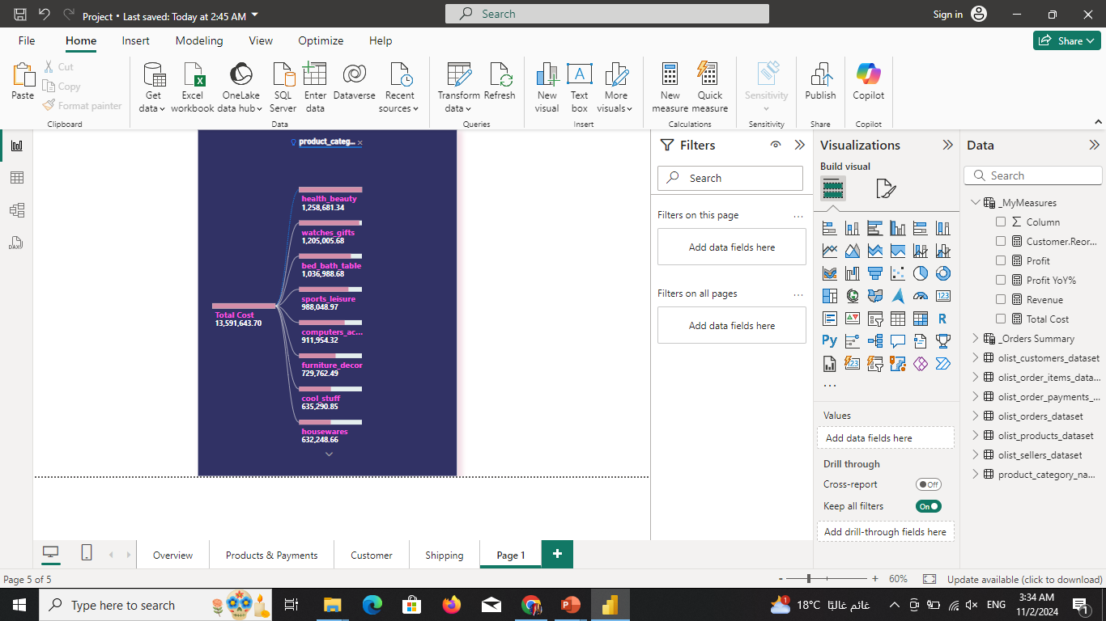

Slide 9

Insights
Recommendations
The most Costly Product Categories are the Highest to generate Profit.
Likewise, the lowest-cost Categories are the lowest to generate profit.
Investing a greater percentage in the high-cost products and a lower percentage in the low-cost products for two reasons:
Increase the overall profit
Ensure the availability of sufficient liquidity to afford high-cost products

Slide 10
Q3
What are the Most & Least Frequently Ordered Categories?

Slide 11

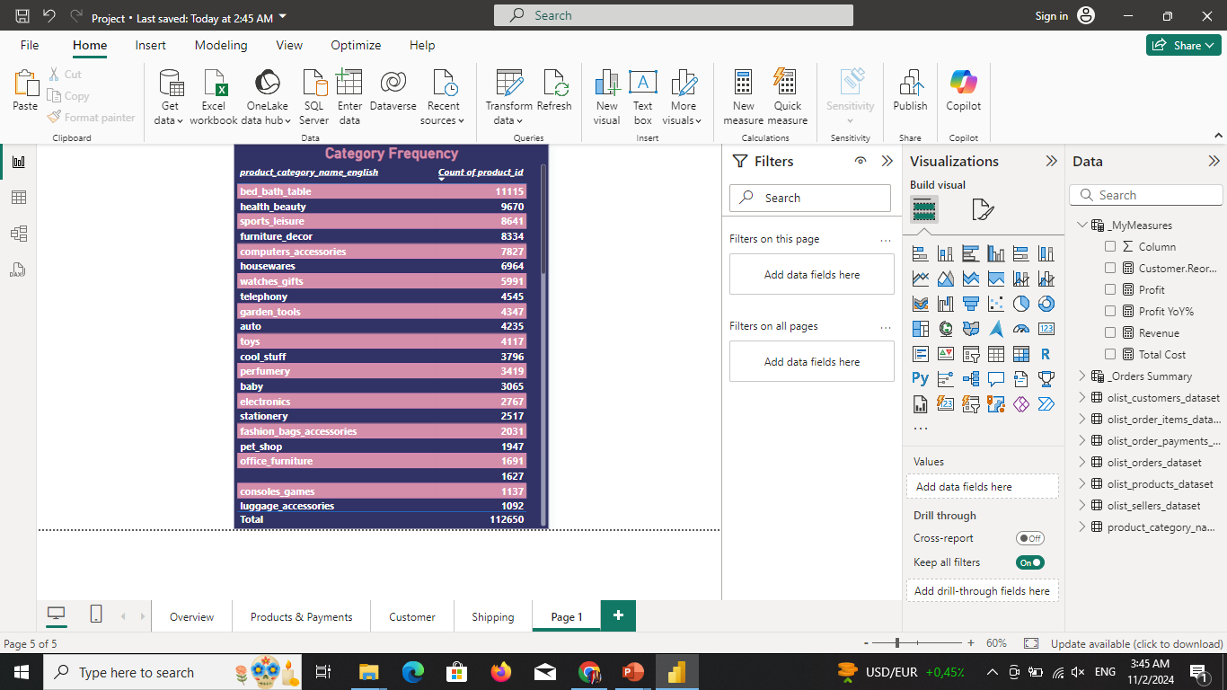
Top Five Frequently ordered Categories:
1. Bed Bath Table: 11115
2. Health Beauty: 9670
3. Sports Leisure: 8641
4. Furniture Décor: 8334
5. Computer Accessories: 7827
Least Five Frequently ordered Categories:
1. Security & Services: 2
2. Fashion Children Clothes: 8
3. La Cuisine: 14
4. CDs-DVDs-Musicals: 14
5. Arts and Craftmanship: 24

Slide 12

Insights
Recommendations
1. Given that top 5 frequently ordered categories generate the highest profit, this observation stresses the importance of investing more in the high-cost product while staying assured that they’re the most frequently ordered. This also insures more profit, and scoring higher overall sales.
2. It’s also desirable to reduce investments in the low-cost products since they’re rarely ordered and the least profitable as previously mentioned
The Same top 5 profitable Categories are the most Frequently Ordered. Likewise, the least 5 profitable categories are the least frequently ordered.

Slide 13
Q4
What are the Payment Methods Used by our customers?

Slide 14
Four Payment Methods
Debit Card (Least Used)
Credit Card (Most Used)
1529 Transactions
1.47 % of all Payments.
76795 Transactions
73.92% of all Payments.
Voucher
Boleto
5775 Transactions
5.56 % of all Payments.
19784 Transactions
19.04 % of all Payments.

Slide 15
Q5
Where does the Business Generate the highest & lowest Profit?

Slide 16

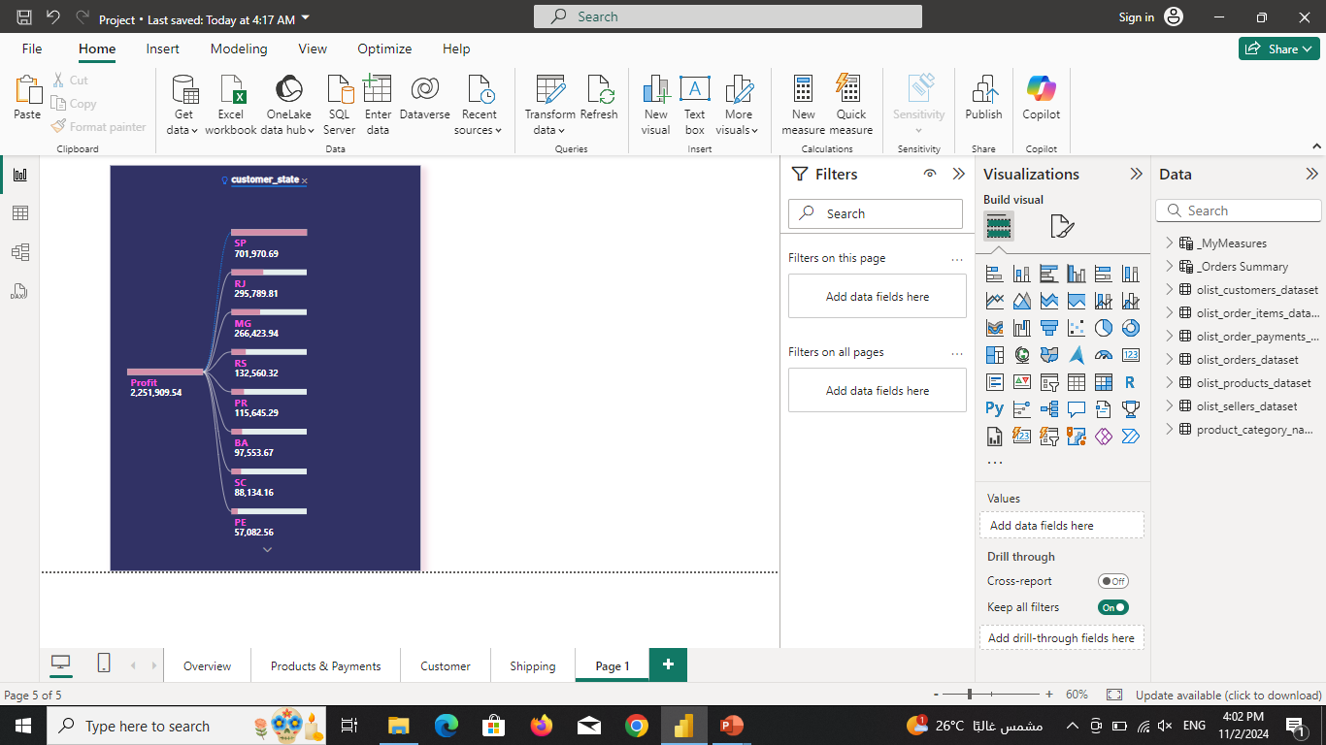
Top 5 States generating the Highest Profit:
SP
RJ
MG
RS
PR

Slide 17
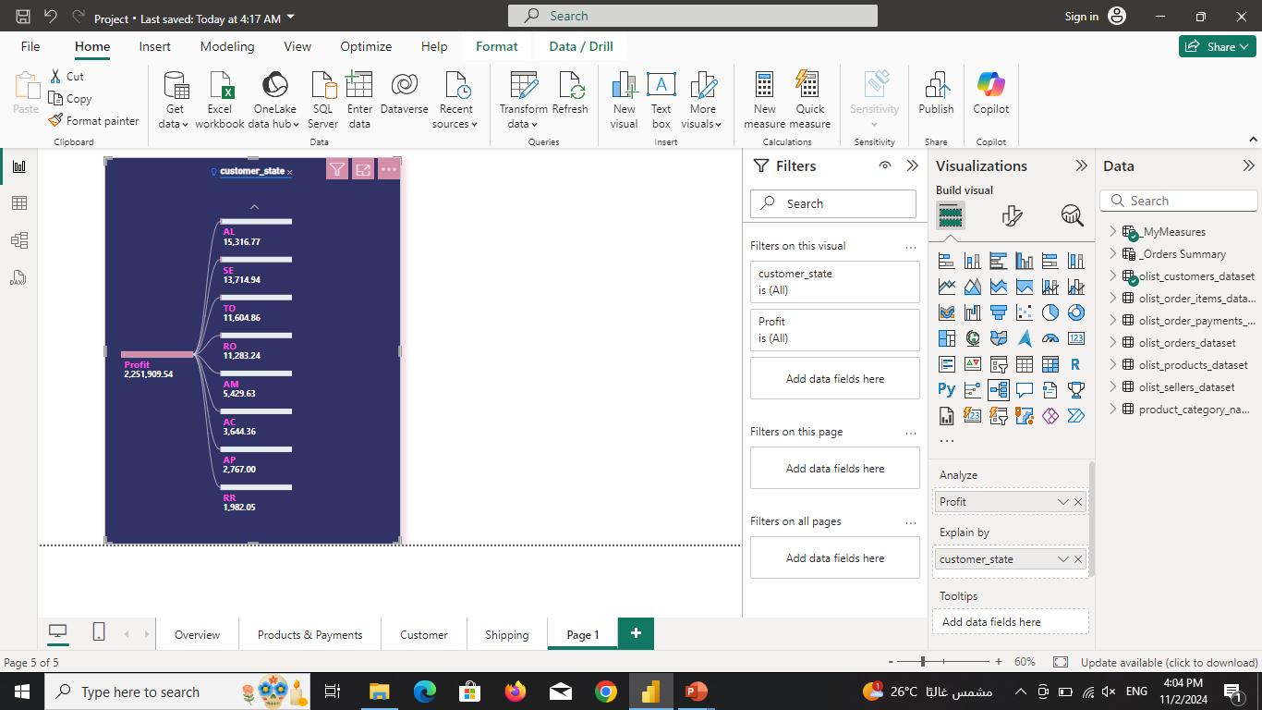
Least 5 States Generating
the lowest Profit
1. RR
2. AP
3. AC
4. AM
5. RO

Slide 18
Insights
Recommendations
The Number of Customers, a great Contributor in generating Profit, is increasing over the years in all Countries; However, the percentage of audience increase in some States is higher than some other states which creates a gap in the profitability among the states.
1. Since the most frequently used payment method is the Credit Card, it’s recommended to build partnerships with the region banks and Financial Institutions to offer discounts or cash-back packages to encourage audience increase that would increase the overall profit, especially in the least profitable states.
2. Another proposal to promote sales in the least profitable states is to invest in catchy Bill Boards that would increase the brand awareness among the state residents.

Slide 19
Q6
How Long does it take for an order to arrive to the Customer?

Slide 20

Order Timeline Series
Order
Avg 2.5 Days
From Olist to the Carrier
Avg 9 Nine Days
From the Carrier to the Customer
Total Avg 11. 5 Days
From the order estimated Date to the Customer

Slide 21
Insights
0%
Arrive on Time
91.89%
arrive earlier than the estimated date
8.11%
arrive delayed than the estimated date
Recommendation
Since the Majority of the days are consumer by the carrier, it’s better to agree with the logistic Partner to sustain the good performance of delivering the order either on time or in advance to maintain Customer Satisfaction

Slide 22

THANKS! E N G Y M A B R O U K

